Slide 1

Alpha Team Presents: Film Insights
Presented on: January 31, 2023
Hosted by:
Oleksandr Biruk, Khaled Laila, and Lela Wall

Slide 2

Agenda
1. Introduction
2. Alex: Analysis of the whole database and narrowing it down
3. Khaled: Find facts about movies
4. Lela: Best Picture Nominees and Winners analysis
5. Summary, final

Slide 3
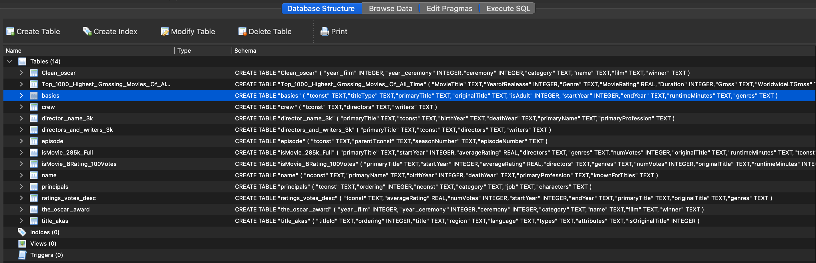
IMDb Database
1,265,785 rows (movies)

Slide 4
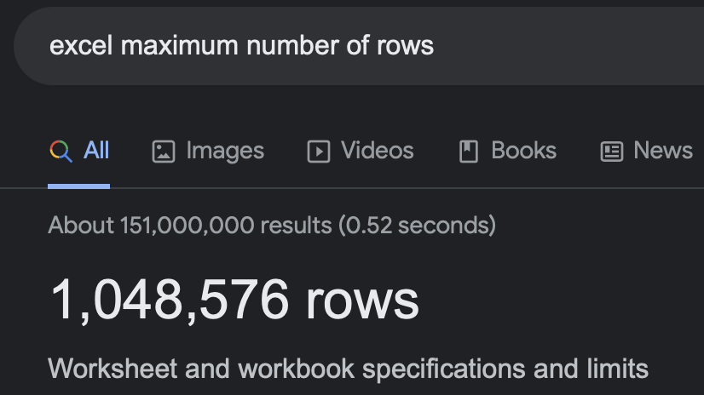
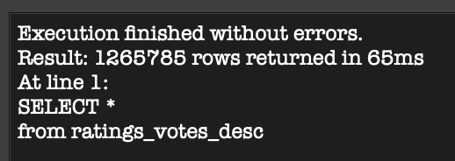
This database is so huge that Excel can’t handle it

Slide 5
All movies in runtime interesting facts
Total # of movies | Total movie length in minutes | in hours | in days | in years
1,265,785 | 119,803,301.00 | 1,996,721.68 | 83,196.74 | 227.94
SQL query:
SELECT SUM(basics.runtimeMinutes)
FROM basics
Result:
119,803,301.00

Slide 6
Number of movies per year

Slide 7
Number of movies produced for the last 10 years

Slide 8
Average rating by genres
History, Documentary and Biography have the highest ratings

Slide 9
Average rating by year

Slide 10
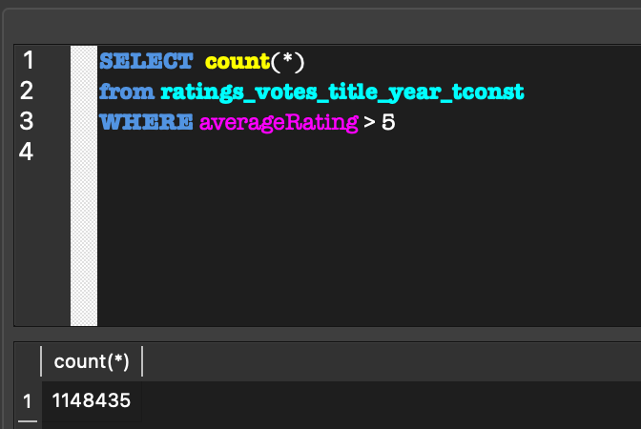
How many movies have rating more than 5?

Slide 11
Insight #1
1 | 2 | 3 | 4 | 5 | 6 | 7 | 8 | 9 | 10
- | - | - | - | 0 | 1 | 2 | 3 | 4 | 5
90.7 % of all movies have rating 5 or more. People tend to start rating movies from 6 as an initial point (not 1).

Slide 12
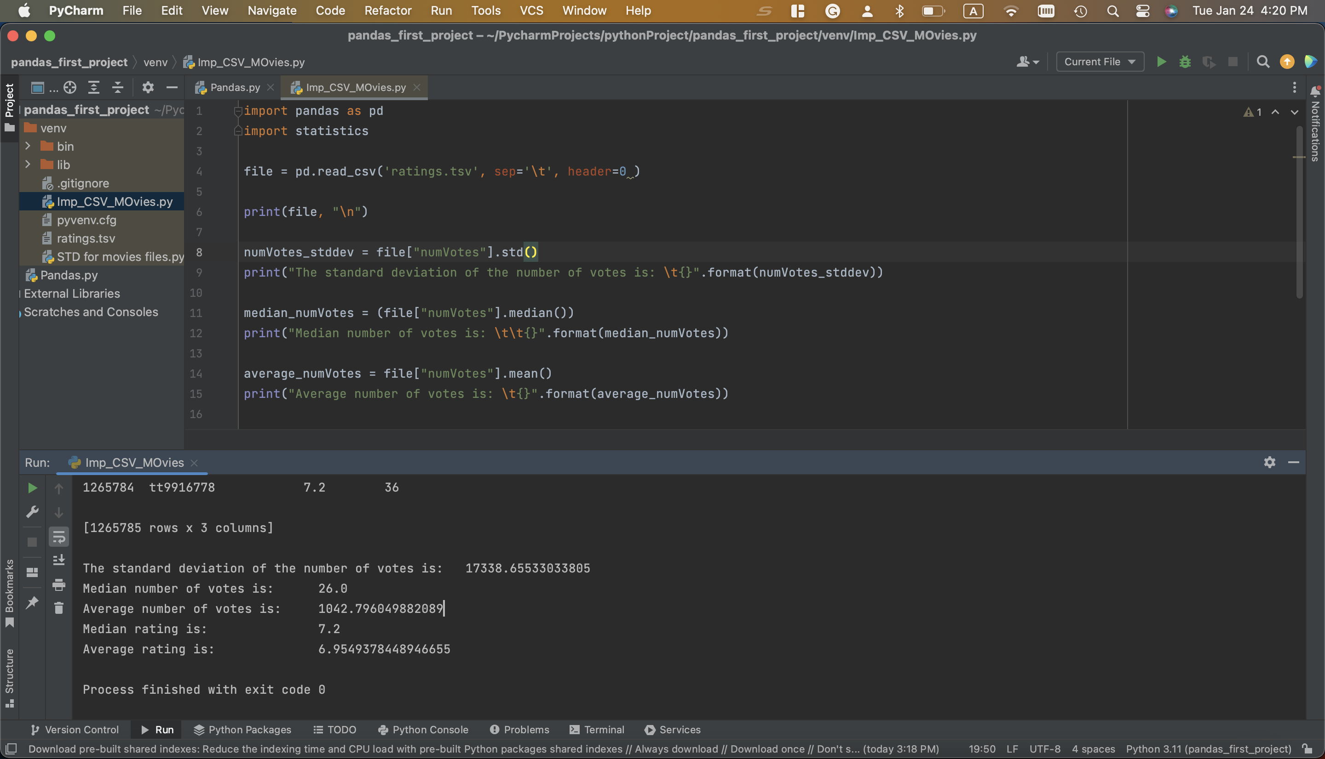

Slide 13

Insight #2
Almost half of all the movies have less the 26 number of votes (given any rating).

Slide 14
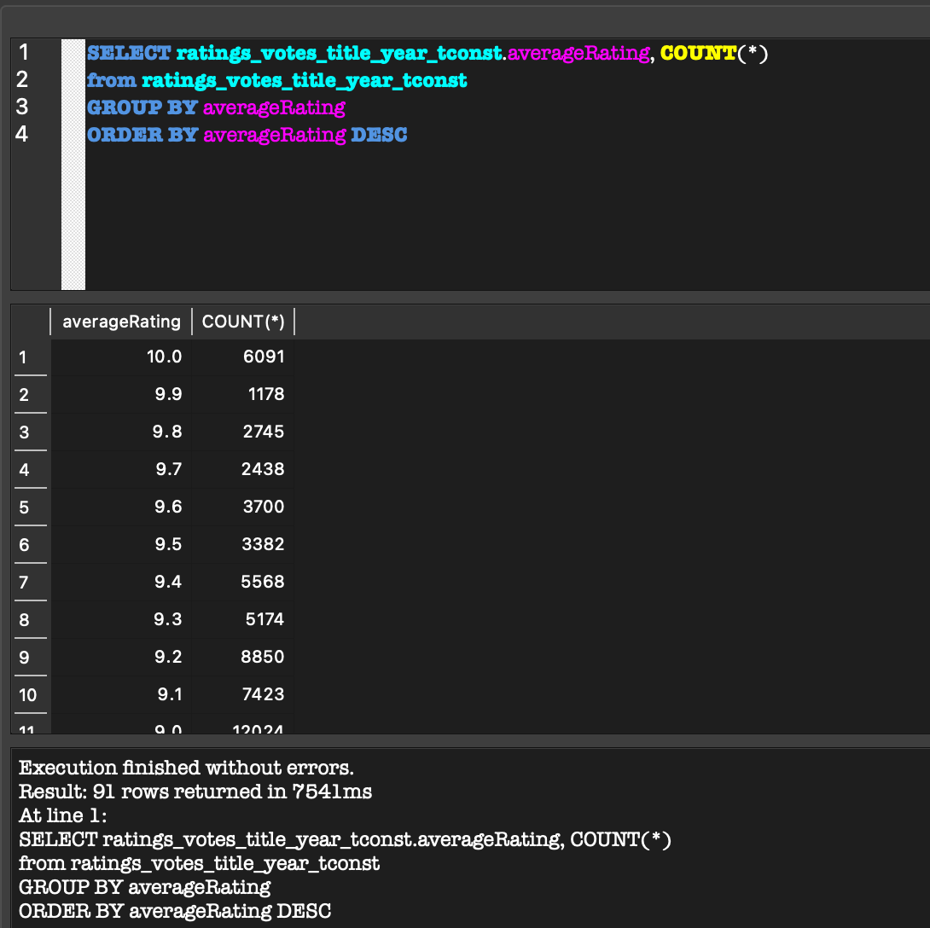
Movies distribution by average rating

Slide 15
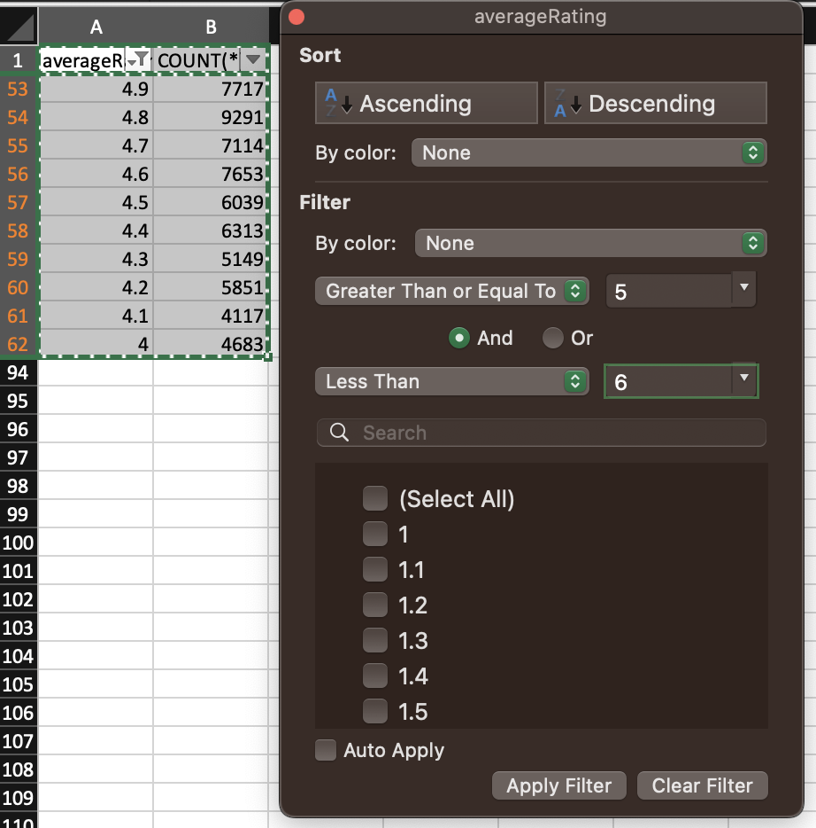
Save those files and exported to Excel (only 92 rows)

Slide 16
Movies distribution by rating

Slide 17
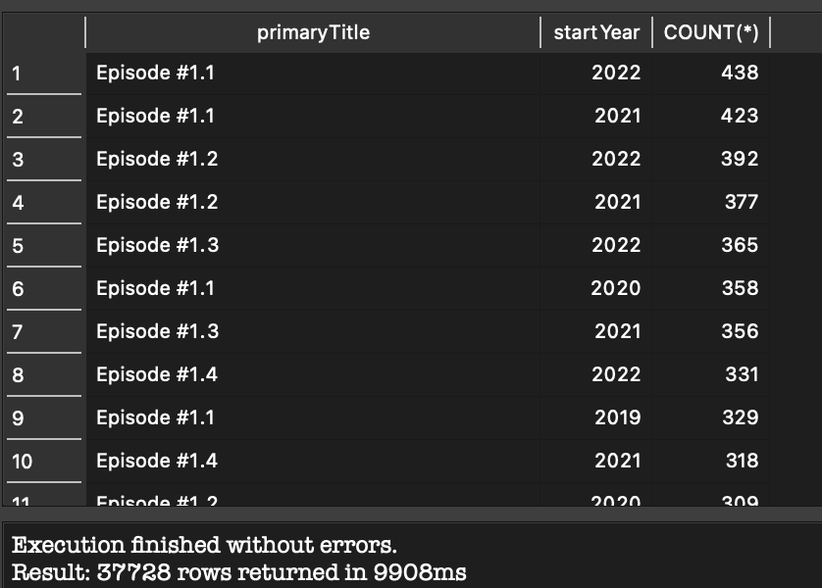
Duplicates

Slide 18
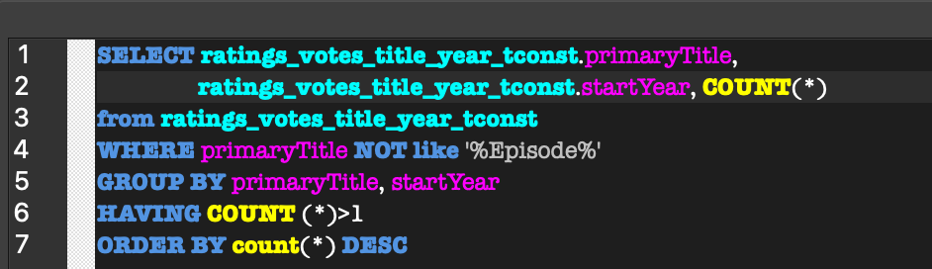
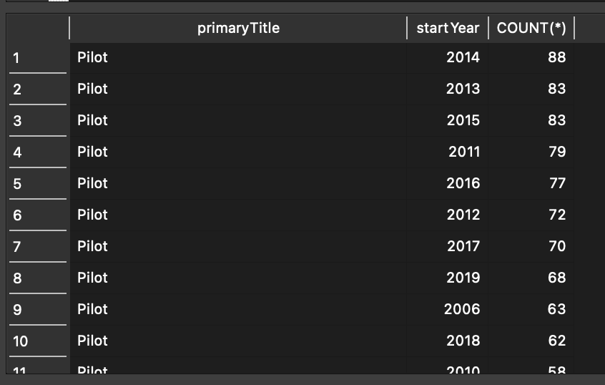
Exclude “Episode” and group by year

Slide 19
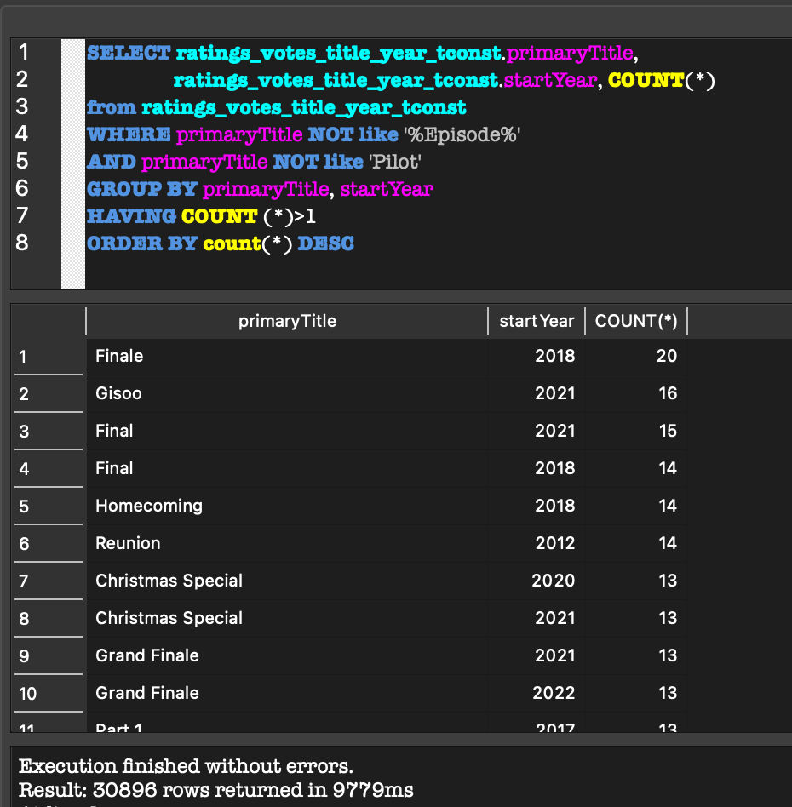
Exclude ”Pilot”

Slide 20

Lesson learned
Spend time to review the schema and database structure

Slide 21
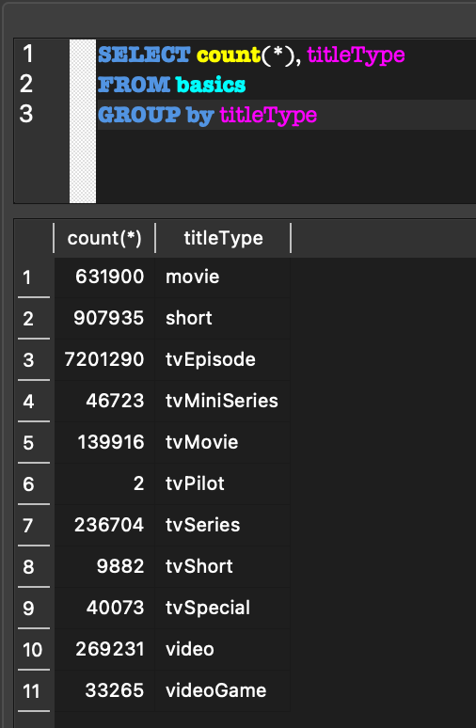
Title type query:

Slide 22
Distribution by movie type

Slide 23
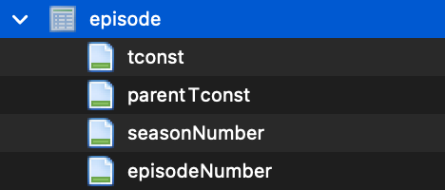
How come there are 7m. tv series if you mentioned that there are only 1m. something movies produced?

Slide 24
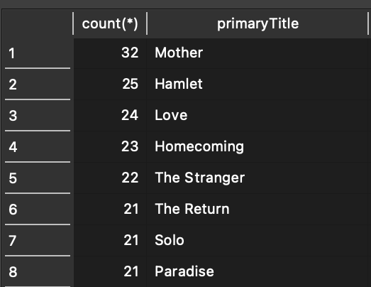
Now let’s check our table

Slide 25
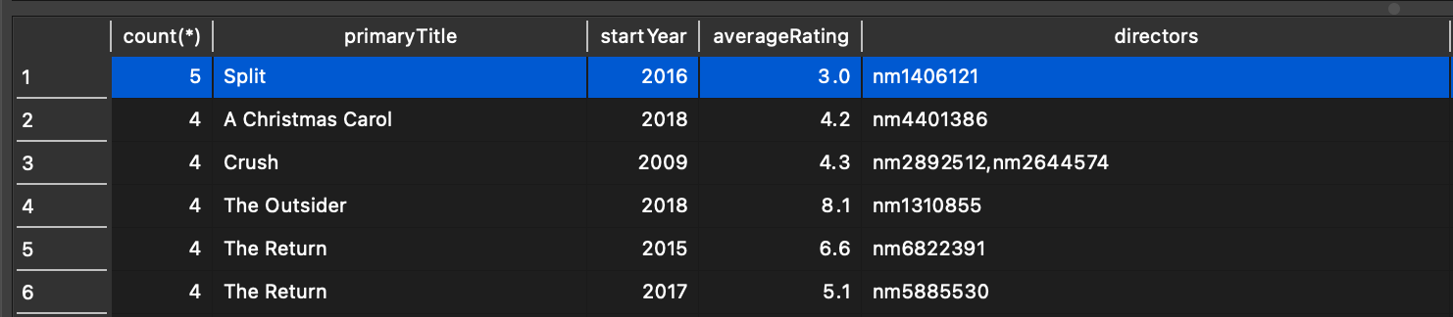
Add year

Slide 26


Slide 27
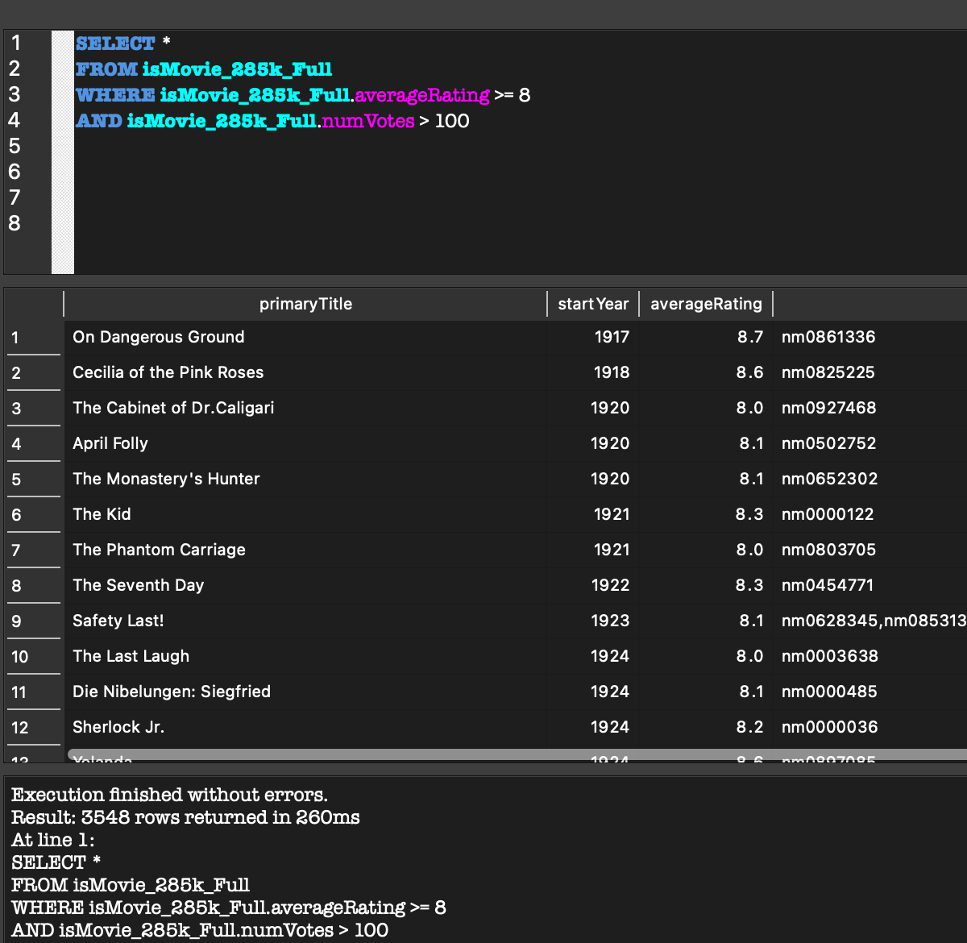
There are only 3,548 movies with rating greater than or equal 8 and with number of rating votes greater than 100

Slide 28
GitHub
Link to our GitHub: click here

Slide 29
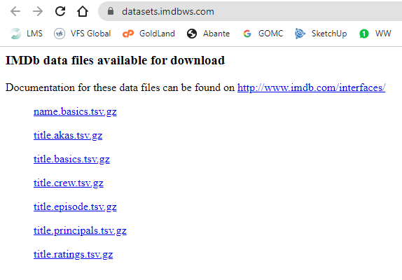
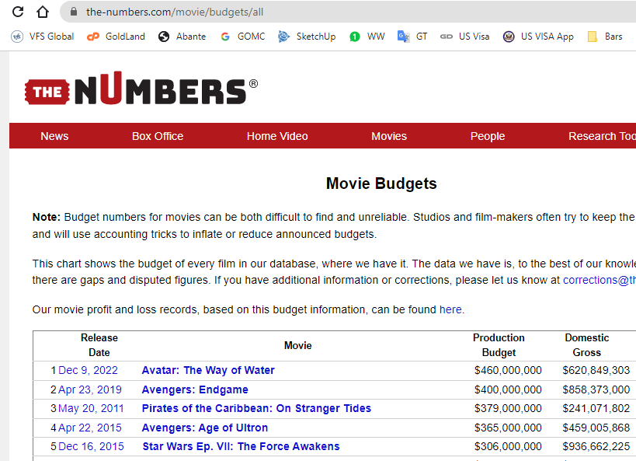
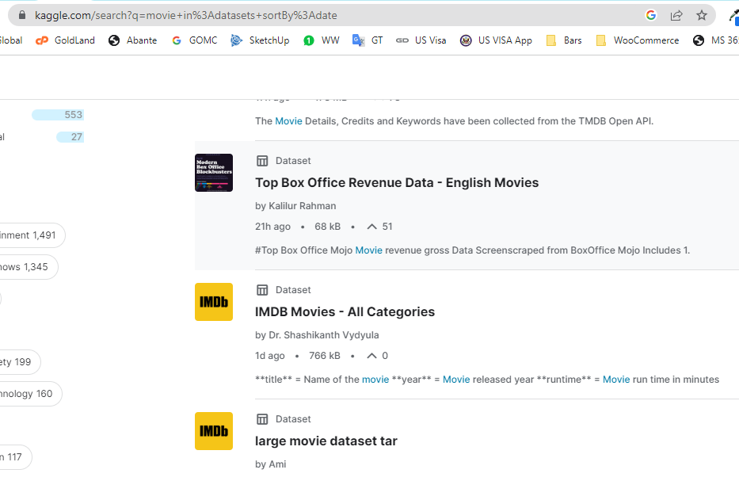
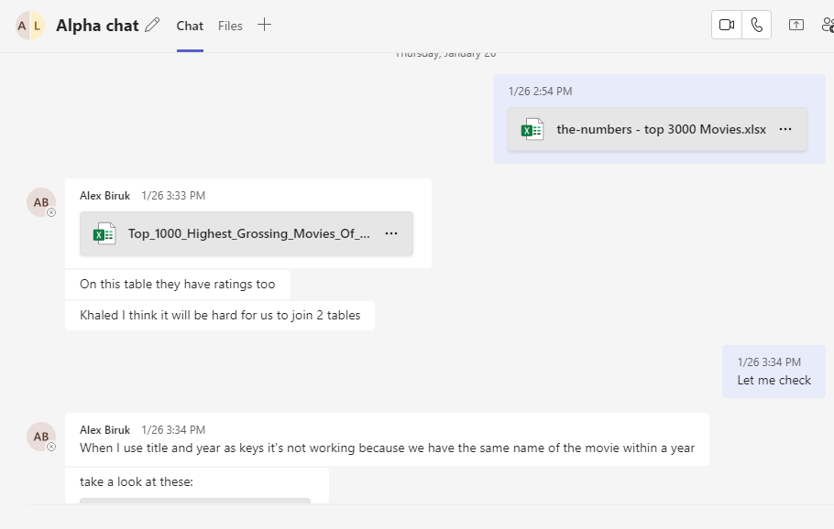
Data Collection
Source of Data
datasets.imdbws.com
The-numbers.com
Kaggle.com
The Project team

Slide 30
Data Collection
Collection Methods
Downloading
Screen Scraping
Copying
Sharing

Slide 31
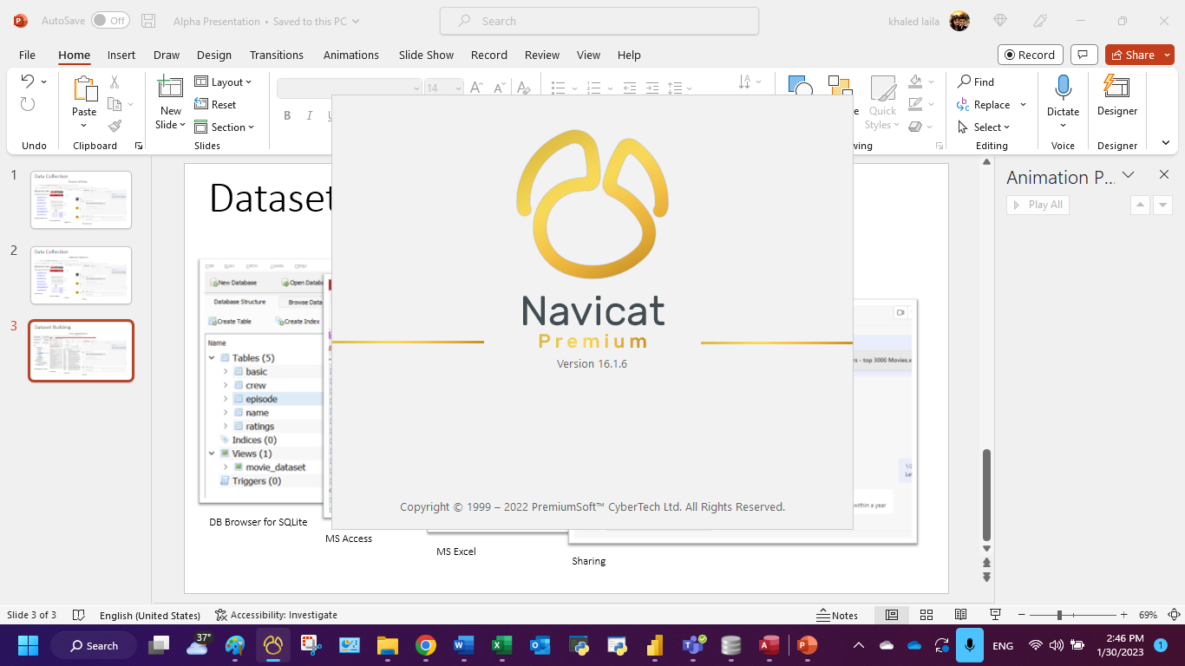
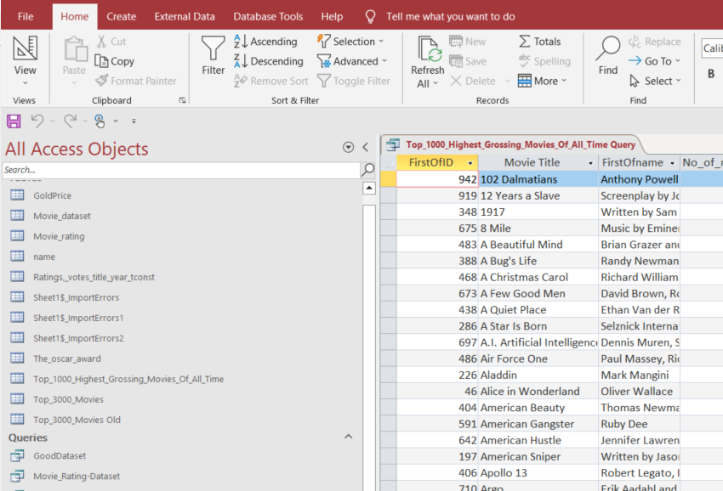
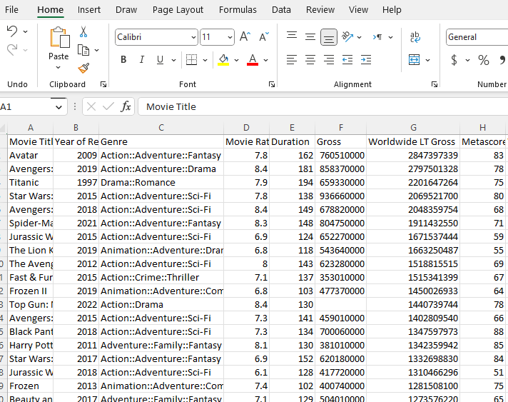
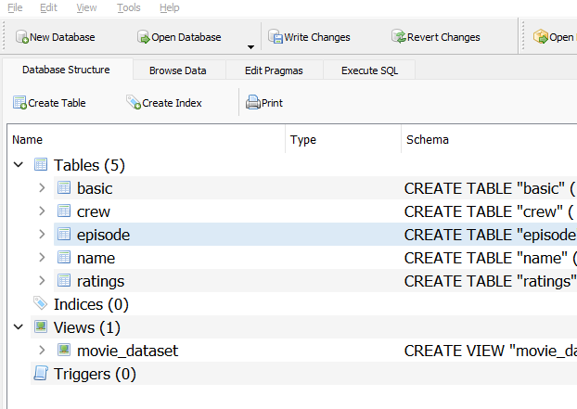
Dataset Building
Used Applications
Navicat Premium 16
MS Access
MS Excel
Db Browser for SQLite

Slide 32
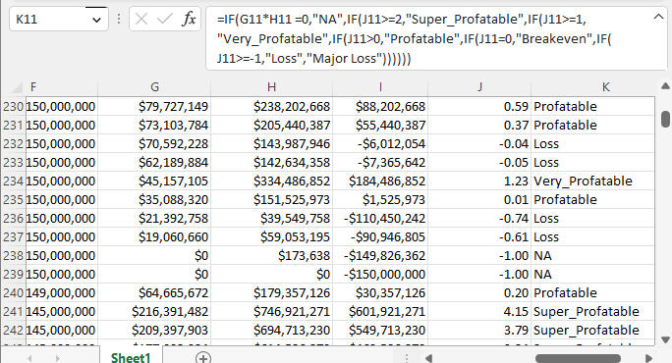
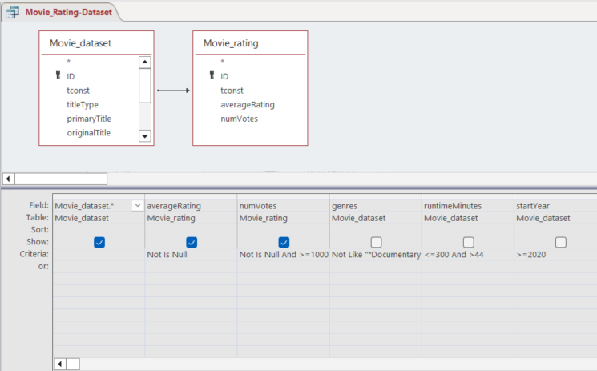
Dataset Building
Create new Column
Join tables
=IF(G2*H2=0,"NA",IF(J2>=2,"Super_Profatable",IF(J2>=1,"Very_Profatable",IF(J2>0,"Profatable",IF(J2=0,"Breakeven",IF(J2>=-1,"Loss","Major Loss"))))))
SELECT Movie_dataset.*, Movie_rating.averageRating, Movie_rating.numVotes
FROM Movie_dataset LEFT JOIN Movie_rating ON Movie_dataset.tconst = Movie_rating.tconst
WHERE ((Not (Movie_rating.averageRating) Is Null) AND (Not (Movie_rating.numVotes) Is Null And (Movie_rating.numVotes)>=1000) AND ((Movie_dataset.genres) Not Like "*Documentary*") AND ((Movie_dataset.runtimeMinutes)<=300 And (Movie_dataset.runtimeMinutes)>44) AND ((Movie_dataset.startYear)>=2020))

Slide 33

Dataset Facts
IMDb Database
Top 3000 movie from the-numbers.com
Movie index the-numbers.com
Top 100 Movie Production Companies
the-numbers.com
No. of records (basic): 9,562,180
No. of records 3,000 (Movie Budgets)
No. of records 50
No. of records 100
SELECT basic.* FROM basic
WHERE Basic.titleType = "movie" and basic.genres <> "\N" and basic.runtimeMinutes <> "\N" and basic.runtimeMinutes> 44 and basic.startYear >= "2000" and basic.startYear <> "\N" and basic.genres not like "%Documentary%" and basic.genres not like "%Biography%"
Movie Budget and Financial Performance Records
Top-grossing movie released in each calendar year (based on worldwide box office)
Number of movies and financial performance records for each company
Delete 110 records (missing data)
Delete produced movies before 1991
Created new column (Profit category)
Convert text data to number
Convert text data to number
Delete 50 records (missing data)
Convert text data to number
No. of filtered records: 91,602
No. of filtered records: 2,767
No. of filtered records: 50
No. of filtered records: 50

Slide 34
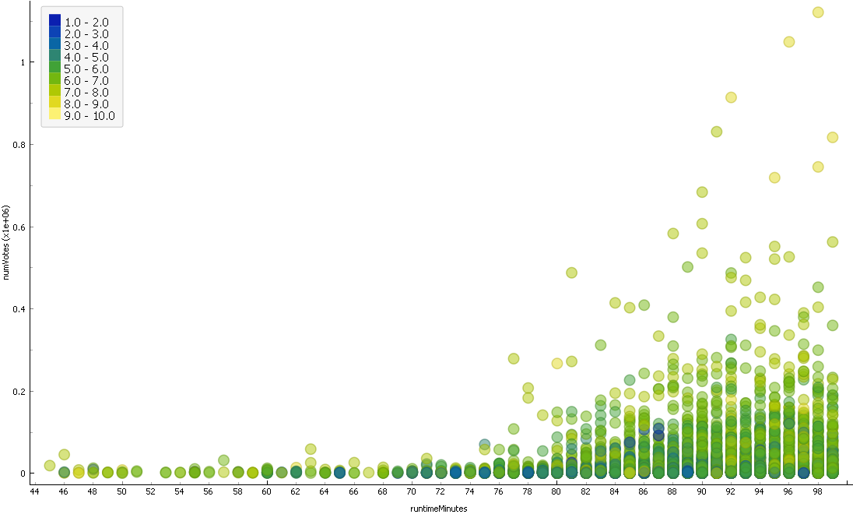
Movie Length and Rating
The finds:
1- The longer movies are getting higher number of votes

Slide 35
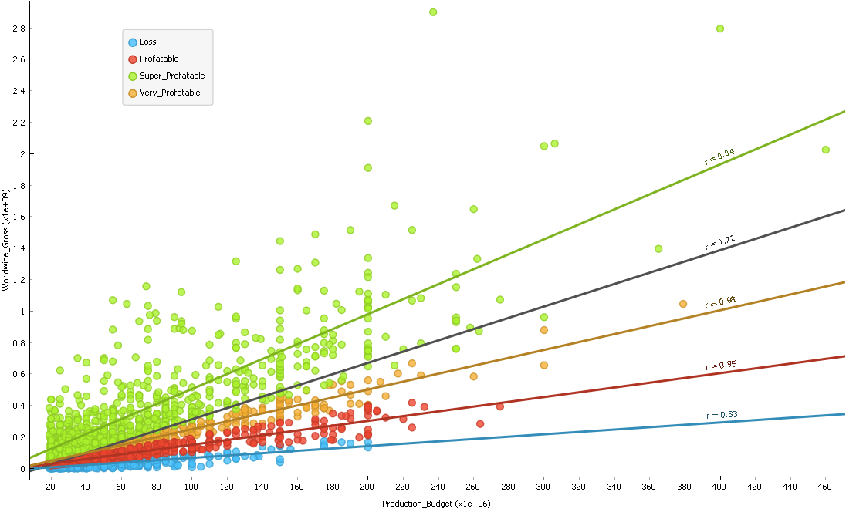
Movie Budget and Financial Performance
The finds:
1- Almost there no strong relation between the production budget and profits.
2- All losing films had budgets under 200M

Slide 36
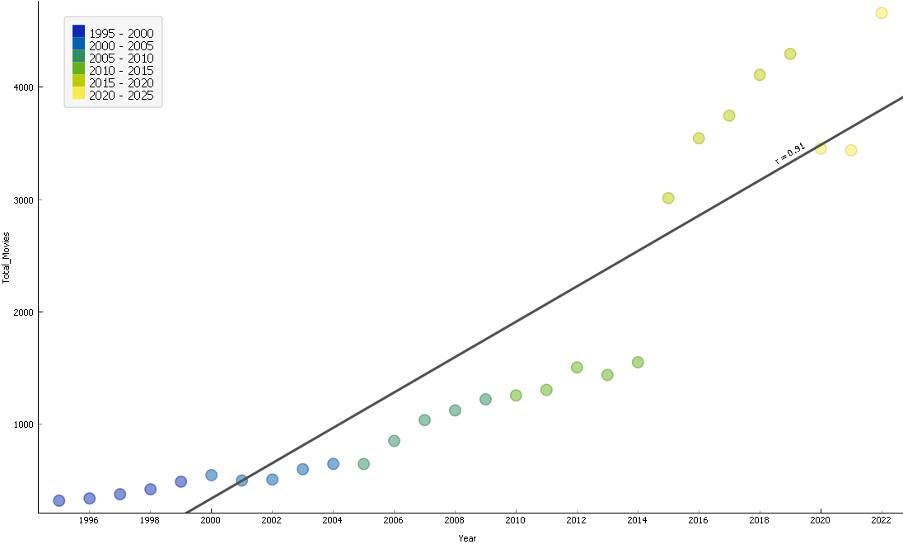
The Movie Stats
The finds:
1- COVID-19 has clear impact on the number of produced movie from 2020 t0 2021.
2- Strong correlation between the number of movies and the year of production (0.91)

Slide 37
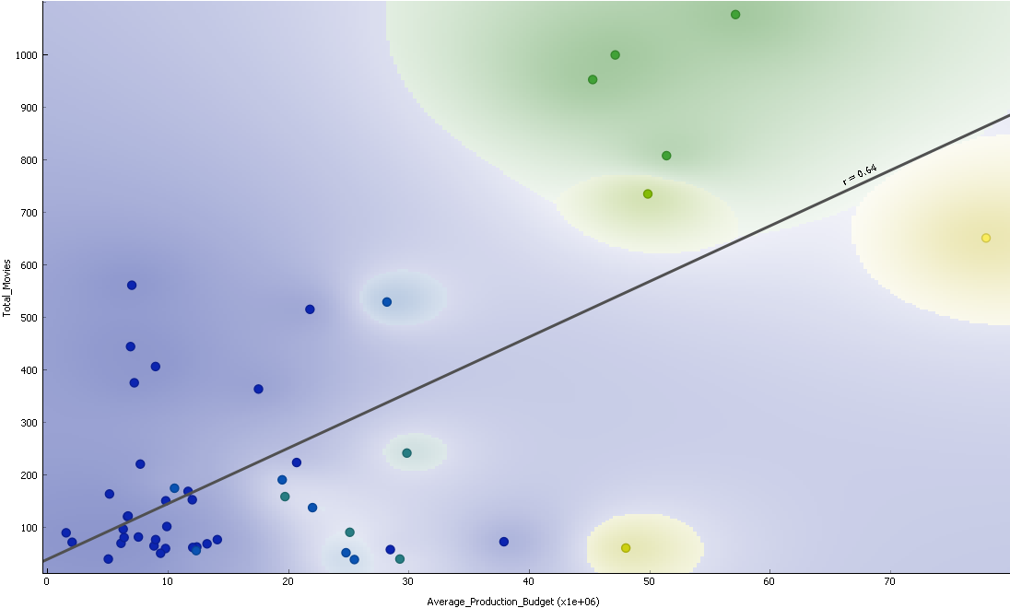
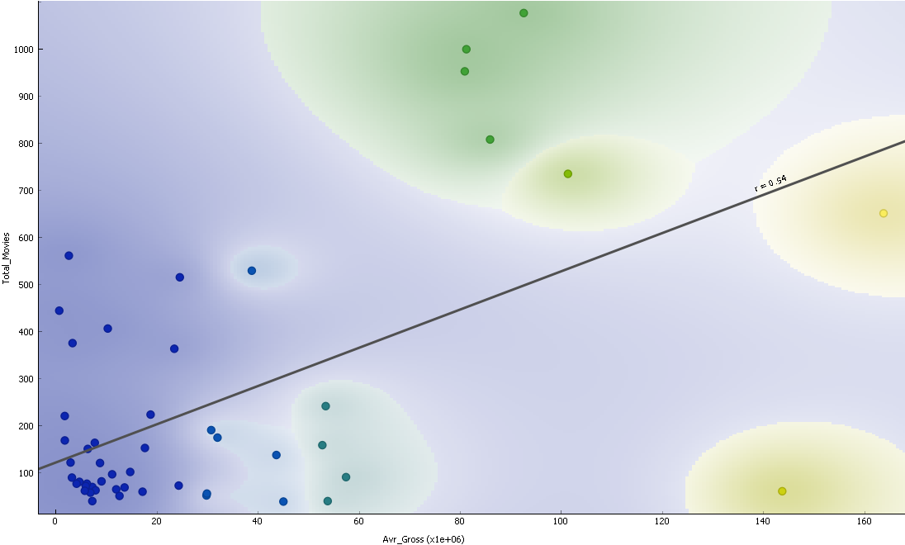
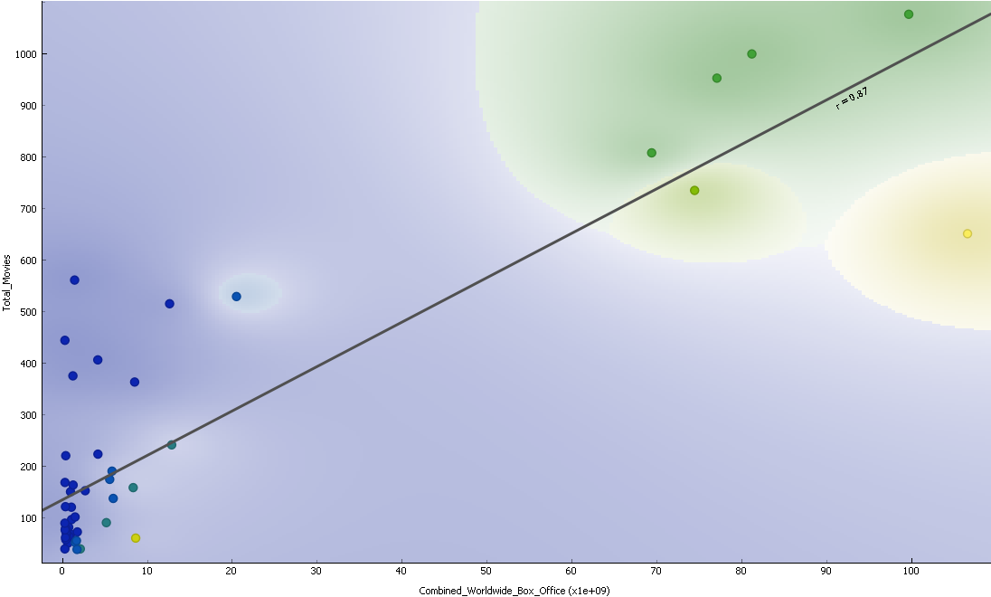
Movie Index
2
1- Total No. of Movies vs Average Gross
2- Total No. of Movies vs Average Budget
3- Total No. of Movies vs Total Gross
Join tables
The finds:
1- The combined of top 10 budgets = 5.4% of the total budget of all companies.
2- the worldwide gross of the top 10 budget is 88% of the total gross
1
3

Slide 38

What Makes a Best Picture?

Slide 39
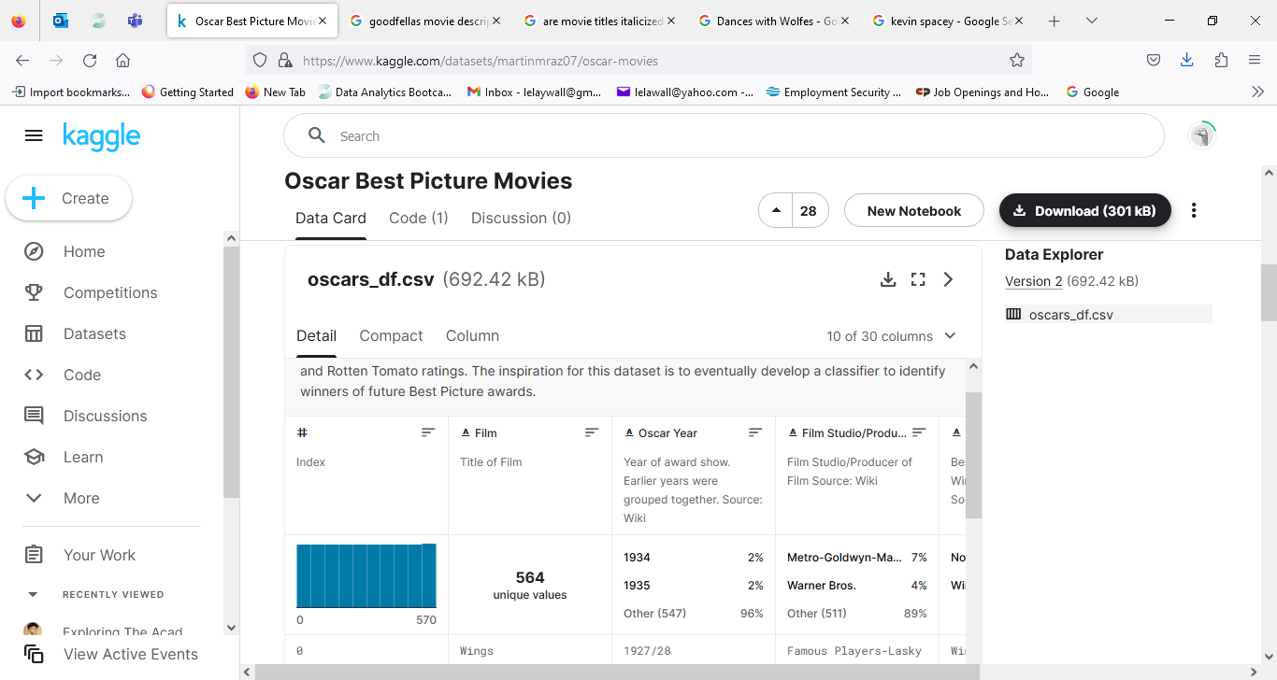
Screenshot of Kaggle with CSV download that included Rotten Tomatoes ratings information.

Slide 40
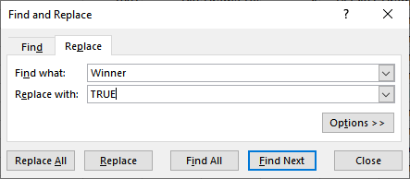
Filter used on Excel to change the data on my spreadsheet.

Slide 41
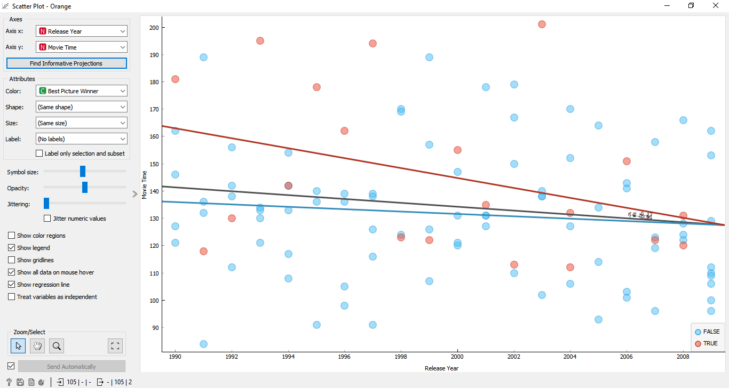
Orange Scatter Plot with movie length range compared for all nominees and winners. The r values are overlapping but appear to be negative when done for all movie lengths.

Slide 42
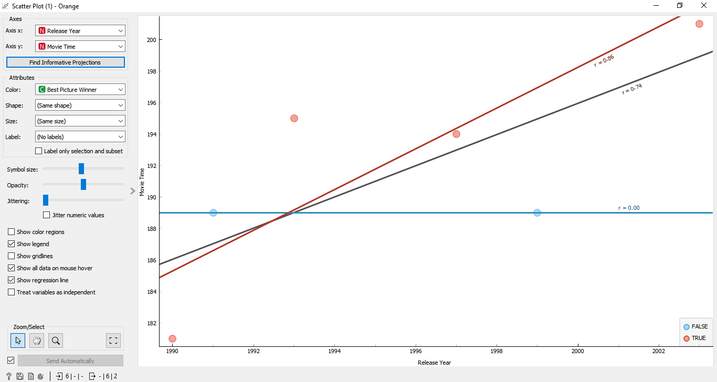
Orange Scatter Plot with movie length field adjusted to a range of 180 to 220. High correlation shown for the TRUE movies that were my Best Picture winners.

Slide 43
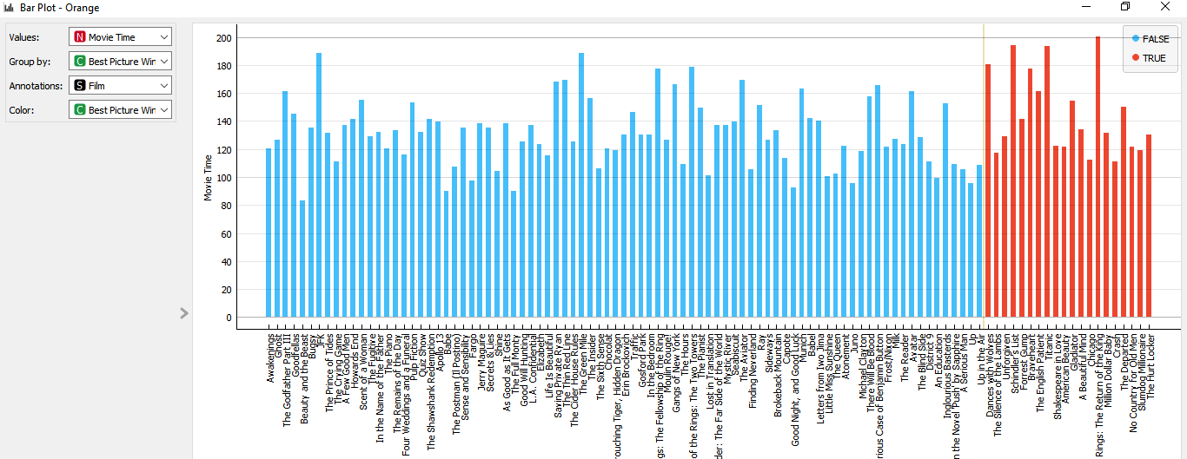
Orange Bar Plot chart that compared movie length for the Best Picture nominees and Best Picture winners.

Slide 44
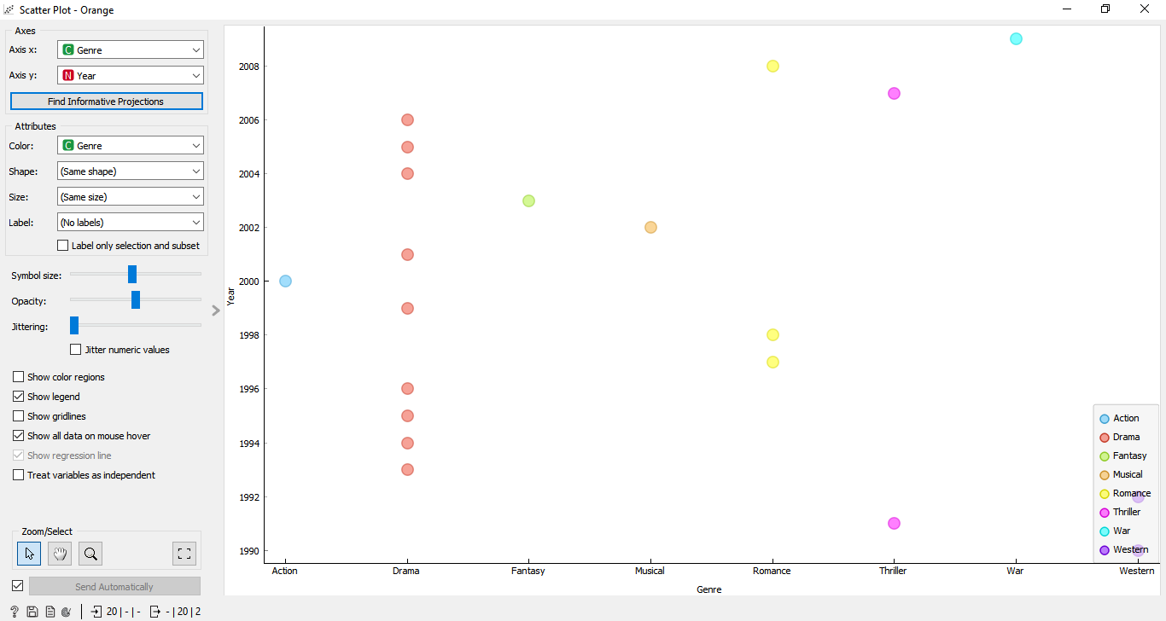
Orange Scatter Plot with the genre for each Best Picture winner for 1990 through 2009.

Slide 45
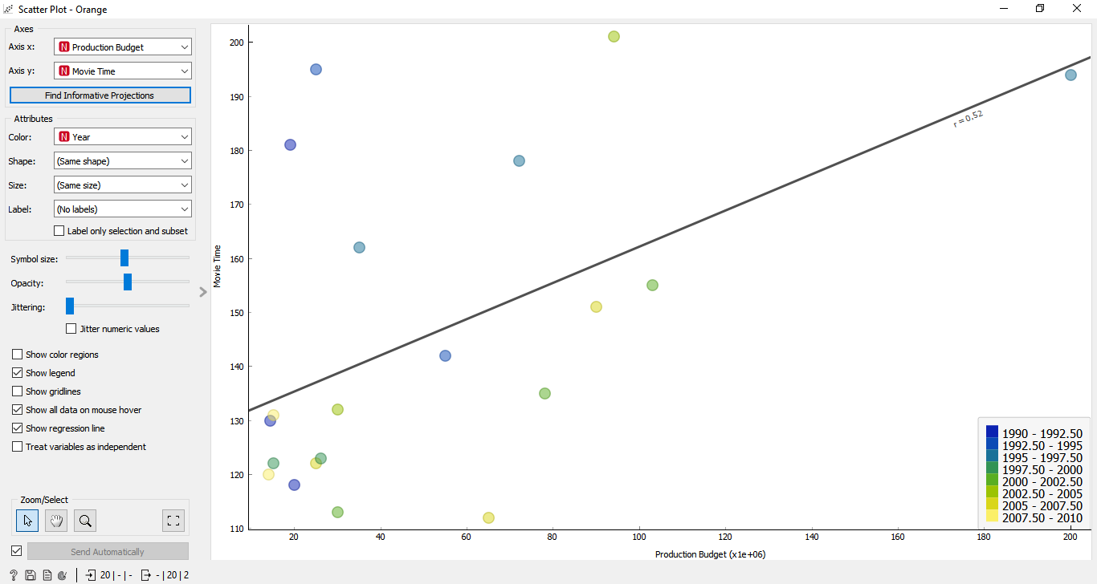
Orange Scatter Plot with budget and movie length compared for the Best Picture Winners.

Slide 46
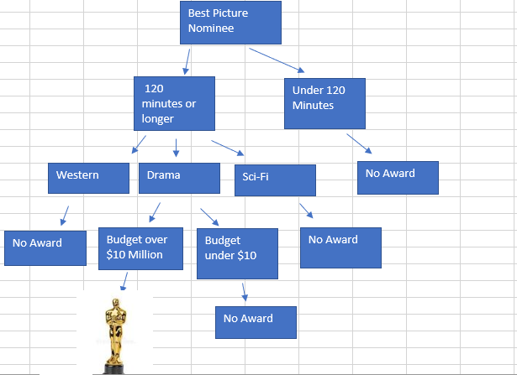
Decision Tree on Excel. Question: There is a Best Picture nominee that is 135 minutes in length, is categorized as a drama, and had a budget of $8 million. According to this Decision Tree, how likely is the movie to win the Best Picture Academy Award?

Slide 47
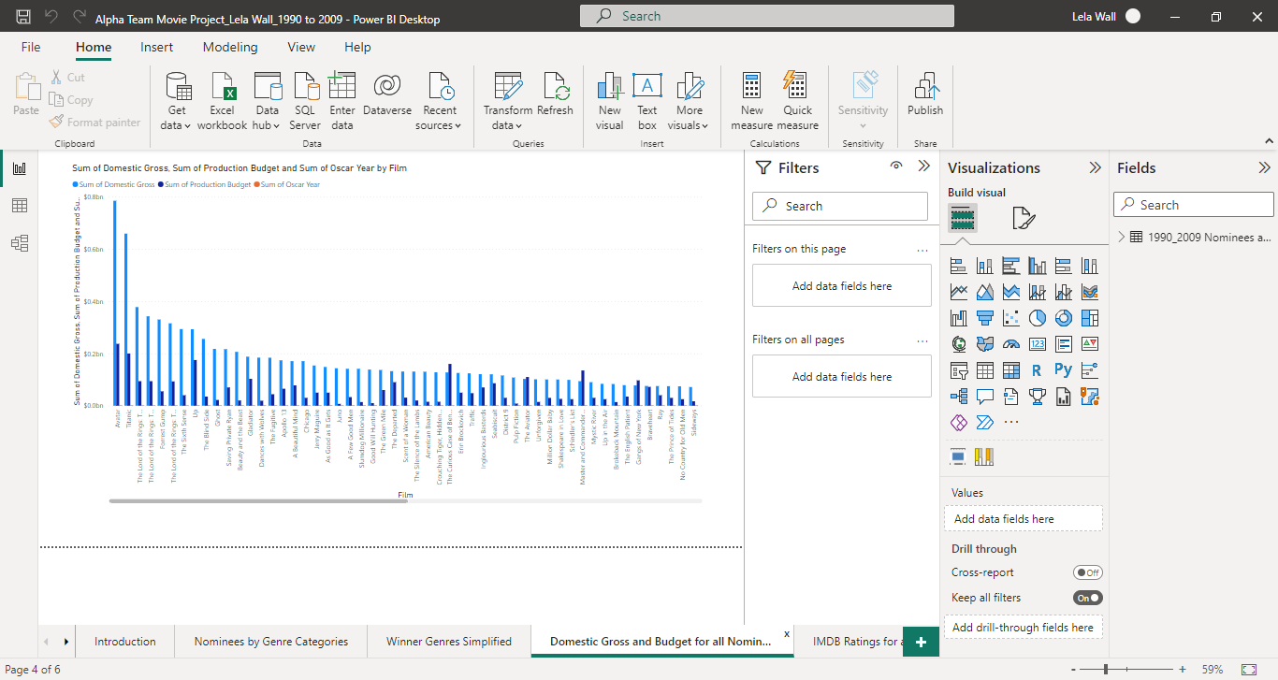
Power BI Bar Chart comparing the sum of the Production Budget and Domestic Gross numbers for each film.

Slide 48
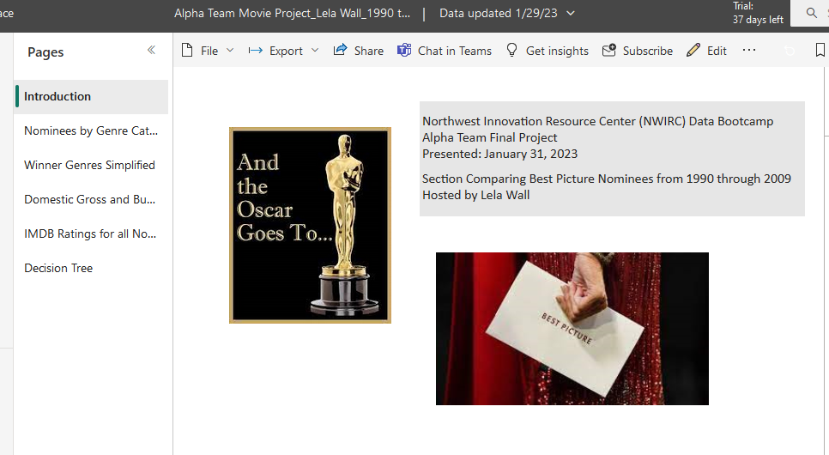
Power BI report shared copy viewed in Power BI Pro App.
Shared PowerBI Report Link

Slide 49

Final Thoughts

Slide 50

Questions?

Slide 51

Thank you!

